Slide 1
Physical Pharmacy Lab 9 CPT 203/PT 203
Isotonicity Part II

Slide 2
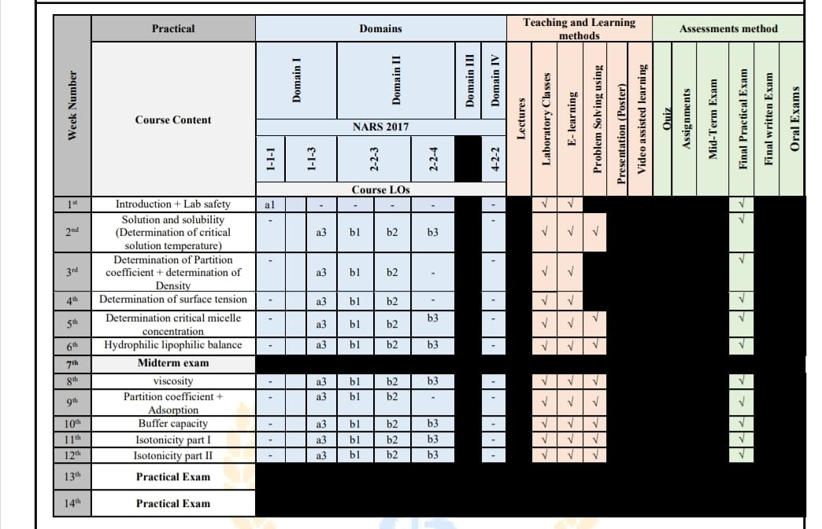

Slide 3
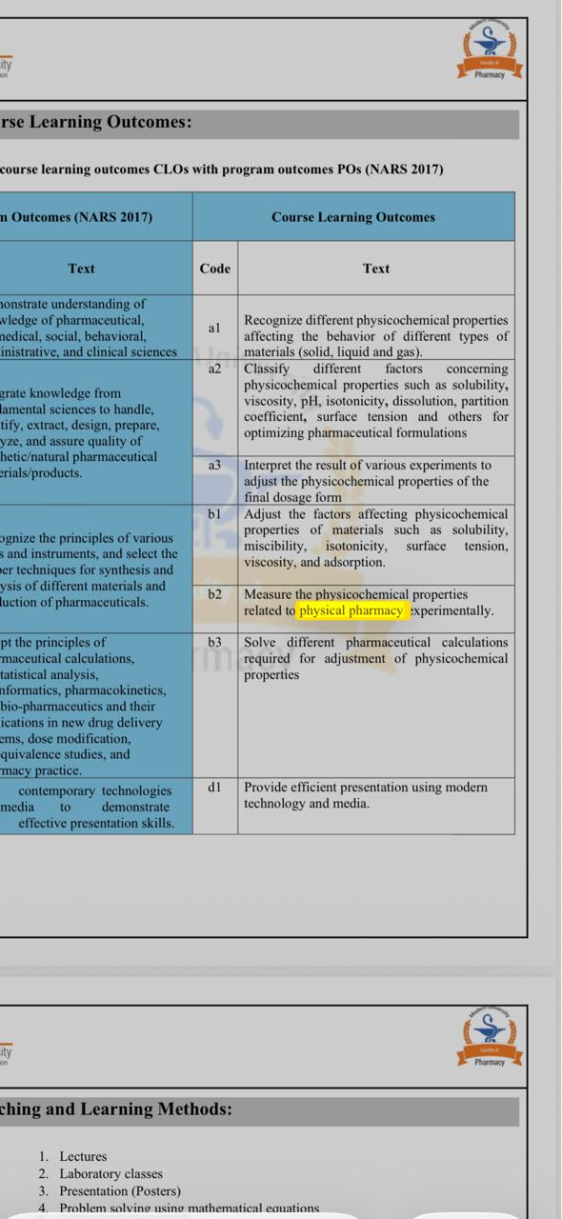

Slide 4
Method of adjusting isotonicity
A) Depending on the solute
NaCl equivalent method
Freezing point depression method (Cryoscopic method)
B) Depending on the water addition
White Vincent method

Slide 5
We use the following equation:
Freezing point depression of blood plasma (◦C)
Freezing point depression of the hypotonic solution (◦C)
W = 0.52 – (a x conc)
b
Weight of the added adjusting agent(g%)
Freezing point depression of 1% solution of adjusting agent (◦C)

Slide 6
Example
How many grams each of lidocaine hydrochloride and sodium chloride are required to prepare 150ml of a 2% w/v solution of lidocaine hydrochloride isotonic with blood plasma?
Freezing point depression of a 1% w/v lidocaine hydrochloride solution is 0.063◦C and that of sodium chloride is 0.576◦C.

Slide 7
Amount of lidocaine Hcl
2 gm 100ml
x 150ml x= 3 g
Amount of NaCl
w= 0.52- a x conc
b
w= 0.52- (0.063 x 2)
0.576
= 0.684 % (g/100ml
0.684 100ml
x 150ml x= 1.026 g

Slide 8
Sodium chloride equivalent method
The sodium chloride equivalent ( E value) :
the amount of sodium chloride (in grams) that has the same osmotic pressure as that of 1 g of the chemical.
The sodium chloride equivalent ( E value)
1gm drug X gm Nacl
0.9% w/v NaCl solution is isotonic .
0.9 gm Nacl / 100 ml solution .
% of sodium chloride for adjustment =
0.9- (% strength of medicament x E)

Slide 9
N.B
If an agent other than sodium chloride such as boric acid, dextrose, sodium or potassium nitrate is to be used to make a solution isotonic, divide the amount of NaCl by NaCl equivalent of the substance used to adjust Isotonicity.
Notes:
NaCl = 0.2 gm ×××××××÷
Dextrose …… E value = 0.13 gm
??????
0.13 NaCl……. 1 gm Dextrose
0.2 NaCl…… xxx
D = amount NaCl needed / e value adjustment

Slide 10
1 ) How much NaCl should be added to adjust the isotonicity of 50 mL 1% ephedrine SO4 ?(E=0.13)
Answer
% of sodium chloride for adjustment = 0.9- (% strength of medicament x E)
% of sodium chloride for adjustment = 0.9- (1x0.13)=0.77 %
This means that 0.77gm of NaCl must be added to each 100 mL to make it isotonic
For 5o ml of isotonic ephedrine SO4
0.77 gm 100 ml
X 50 ml
0.77x 50/100= 38.5/100 = 0.385 gm of Nacl should be added to 50 ml ephedrine solution

Slide 11
A- solution contains 1 gm of ephedrine sulfate in a volume of 100 ml, what quantity of sodium chloride must be added to make the solution isotonic ?
B- If we used dextrose as an adjusting agent, How much dextrose should be added to make isotonic solution?
NaCl equivalent (E) of Ephedrine sulfate and dextrose are 0.23 gm and 0.16 gm respectively

Slide 12
Answer
% of sodium chloride for adjustment = 0.9- (% strength of medicament x E)
% of sodium chloride for adjustment = 0.9- (1x0.23)= 0.67 %
Which means 0.67gm of NaCl must be added to each 100 mL to make it isotonic
Dextrose
If it is desired to use dextrose instead of sodium chloride for adjusting the tonicity, NaCl equivalent of dextrose = 0.16
1gm dextrose 0.16 gm NaCl
X gm dextrose 0.67 gm NaCl
X = 4.2 gm of dextrose

Slide 13
3) Calculate the amount of NaCl required to make the following ophthalmic solution isotonic.
Rx
Atropine Sulfate 2% (E=0.13)
NaCl qs
Aqua. dist. q.s. ad. 30 mL

Slide 14
Answer
% of sodium chloride for adjustment = 0.9- (% strength of medicament x E)
% of sodium chloride for adjustment = 0.9- (2 x 0.13)=0.64 %
This means that 0.64gm of NaCl must be added to each 100 mL to make it isotonic
For 3o ml of isotonic Atropine solution
0.64gm 100 ml
X 30 ml
0.64x 30/100= 38.5/100 = 0.19 gm of Nacl should be added to 30 ml Atropine solution

Slide 15
How many grams of NaCl should be used in compounding the following prescription:
Oxytetracyline HCl 0.5% E = 0.12
Tetracaine HCl 2% solution
Sodium Chloride Q.S.
Purified water ad 30 ml
Make isotonic solution
2% solution of Tetracaine HCl is isotonic.

Slide 16
Answer
% of sodium chloride for adjustment = 0.9- (% strength of medicament x E)
% of sodium chloride for adjustment = 0.9- (.5 x 0.12)=0.84 %
This means that 0.84gm of NaCl must be added to each 100 mL to make it isotonic
For 3o ml of isotonic Oxytetracyline HCl
0.84gm 100 ml
X 30 ml
0.84x 30/100= 0.21 gm of Nacl should be added to 30 ml Oxytetracyline HCl

Slide 17
5) How many grams of NaCl should be used in compounding the following prescription:
Pilocarpine nitrate 0.3 g E =0.23
Sod. Chloride Q.S.
Purified water ad 30 ml
Make isotonic solution.

Slide 18
Answer
0.3 gm 30 ml
X 100 ml
0.3x 100/30= 1% pilocarpine nitrate
% of sodium chloride for adjustment = 0.9- (% strength of medicament x E)
% of sodium chloride for adjustment = 0.9- (1 x 0.23)=0.67 %
This means that 0.67gm of NaCl must be added to each 100 mL to make it isotonic
For 3o ml of isotonic pilocarpine nitrate
0.67gm 100 ml
X 30 ml
0.67x 30/100= 0.201 gm of Nacl should be added to 30 ml pilocarpine nitrate

Slide 19
White-Vincent Method
It involves addition of water to drugs to make an isotonic solution followed by addition of an isotonic solution or buffer solution to bring the solution to final volume.
V = W x E x 111.1
V= volume of water (The unit is ml)
W= Weight of drug
E =NaCl equivalent Value of the drug
111.1= constant
If we have more than one drug , the equation will be :
V = { (E x W)1 + (E x W)2 + ………… } x 111.1

Slide 20
Rx:
Chloramphenicol--------------------- 1g E=0.1
Purified water ad to------------------100 ml
Make isotonic solution applying the White-Vincent equation.
Answer:
V= W x E x 111.1
= (1 x 0.1) x 111.1
= 11.11 ml
So to prepare 100 ml isotonic solution of this prescription we first dissolve the drug into 11.11 mL distilled water and then complete the volume with isotonic solution (Normal Saline 0.9 % NaCl)
( i.e the amount of added normal saline = 100-11.11=88.89 ml).

Slide 21
R/
Phenacaine hydrochloride -----------------------------------0.06 g
Boric acid-----------------------------------------------------------0.3 g
Sterilized water to-------------------------------------------------100 ml
The sodium chloride equivalent of phenacaine hydrochloride is 0.16 and of boric acid is 0.5
Answer:
V= [(W1x E1) + (W2x E2) ]x 111.1
= [ (0.06 x 0.16) + (0.3x 0.5)] x 111.1
= 17.7 ml
So to prepare 100 ml isotonic solution of this prescription we first dissolve drugs into 17.7 mL distilled water and then complete the volume with isotonic solution (Normal Saline 0.9 % NaCl)
( i.e the amount of added normal saline = 100-17.7=82.3 ml).

Slide 22


